Slide 1

Noughts and Crosses Frontend Workshop

Slide 2
Summary
We will develop a browser based Noughts and Crosses game over 8 exercises.
The starting assets can be found at and can be downloaded from: https://github.com/NGWorkshopMaterials?tab=repositories
We can use the online code editor jsfiddle:
JSFiddle - Code Playground
In the download folder there are three different files. A HTML, a JavaScript and a CSS file:

Slide 3



JavaScript, HTML & CSS explained
These three file types form the backbone of many web applications. What is the difference between them?
HTML – Create the Structure:
Controls the layout of content.
Provides structure for web page design.
The fundamental building block of any webpage.
CSS – Stylize the Website:
Applies style to web page elements.
Targets various screen sizes to make web pages responsive.
Primarily handles the ‘look and feel’ of a web page.
JavaScript – Increase Interactivity:
Adds interactivity to a web page.
Handles complex functions and features.
Programmatic code which enhances functionality.

Slide 4
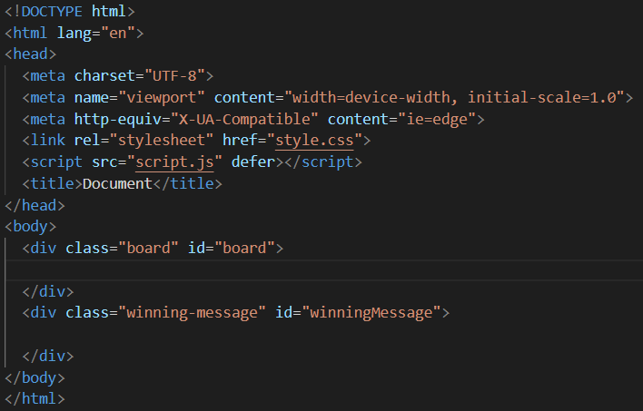
Exercise 1 – Creating the board
The first thing we need to make is the board that the game will be played on. To start with, index.html looks something like this:
We will be editing the body section. Within the body there is a div (division) section with class=”board”, here is where we will build the components for our board section. HTML elements can have class attributes assigned to them and we can then write a CSS rule to select that use cases of that class.
The head section (between <head> and </head>) contains some information for scaling the display and linking the html file to style.css and script.js.

Slide 5
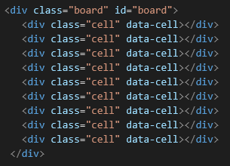
Noughts and Crosses contains 9 cells in a 3x3 grid. For now we are just going to fill the div class with 9 divs with the class of “cell”:
So the div should now look like:
If we saved now and double clicked the HTML file in the file explorer, nothing would show up on the webpage as we’ve not yet formatted anything about the board.
To format the cells and the board, we are going to add a couple sections to style.css

Slide 6
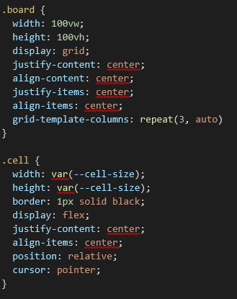
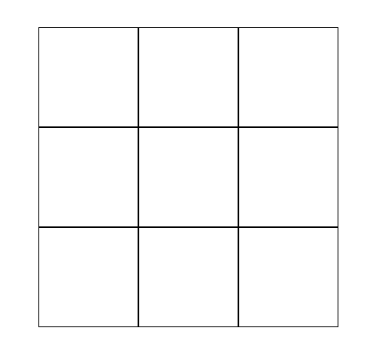
style.css
If we add the following lines on the line after the body curly bracket closes, we should see something different:
And loading up the webpage now yields:
So we’ve successfully made our first HTML components and formatted them with CSS!

Slide 7
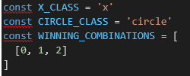
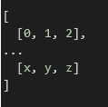
Exercise 2 - Win conditions and game start
Now that we’ve set the stage for the game, it’s time to code some logic into it with JavaScript.
We first need to define two constants for noughts and crosses and a set of winning conditions for the game to end. So we can start with the code:
At the moment there is only one winning combination. The cells are numbered using the scheme of:
0 1 2
3 4 5
6 7 8
So the simplest win would be the line of 1, 2 and 3. Have a think about how many winning combinations there are and see if you can code these into the list. Multiple combinations can be implemented in the format:

Slide 8


As there are multiple of the data-cell elements, we will have to use querySelectorAll() to retrieve them all:
Now we are going to make a function called startGame()
We need to do a couple things with this function:
Ensure the game board is cleared from previous games ready for a fresh start.
Set up listeners for clicks on cells and have it trigger a click handler function.
The first line of this function should set the turn to X starting. To determine the current turn we can use a Boolean as there is only 2 states. You can name it whatever you like, for this demonstration we will call it ‘circleTurn’ and set its value to false:

Slide 9
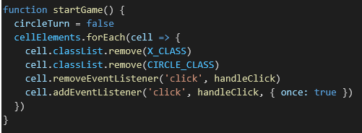
Then we need a way of checking each cell.
A for loop works best here as the cellElements variable is a list and JavaScript comes with a function that can operate on the list class and to loop through it this is quite simple.
We can write “cellElements.forEach” to go through the cells one by one.
We then want to use the .remove function to remove any O’s or X’s already in the cell.
We will remove any event listeners from previous games and create a new one. Your function should look something like this:

Slide 10


Exercise 3 – Click handler
JavaScript enables us to add listeners to HTML components. The most simple of these is probably the click listener which is what we added to our 9 cells in exercise 2. We call a function called ‘handleClick’, but this doesn’t yet exist. So let’s make it.
The click will give one argument to the handleClick() function – a variable called ‘e’ so the first thing we need to do is to rename this to something more readable. Then we need to check which players turn it is so we can fill the cell with the correct symbol:
We’re then going to call a separate function to deal with filling the cells called ‘placeMark’:
Having this in its own function may seem trivial but it’s important to keep functions simple and to serve simple purposes.

Slide 11
Exercise 4 – End game
Back in the handleClick() function we are going to check if any win conditions have been met as the turn is now over. We will user another function called ‘checkWin()’ where in the brackets we can feed in the variable currentClass which determines which turn it is to see if that player has won yet.
In this function we want to check the list of winning combinations we made earlier and see if any have been satisfied. See if you are able to do this and have the function return true if it has been satisfied and false if it hasn’t. (Hint: look up the JavaScript ‘some()’ method).
We also need some logic in the event handler using if, else if and else to determine if the game is won, a draw or still ongoing. You should end up with something like…

Slide 12
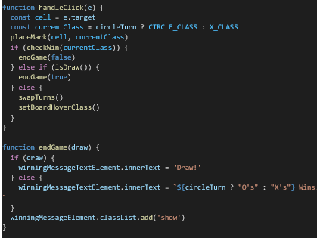
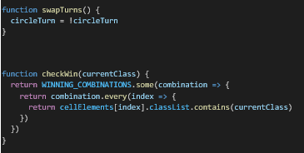
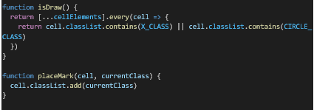
To summarise the click event:
When a player clicks on a cell, the event listener for the cell triggers the handle click function.
This sets cell as the target, determines which symbol should be used and assigns that symbol to the cell.
We then check if the game is over. Triggering the endgame function if so.
If the game is a draw (i.e. all tiles filled in with no win condition satisfied) the game ends
Else (none of the two prior statements happened) we swap the turns to the other team and listen for the next click.

Slide 13
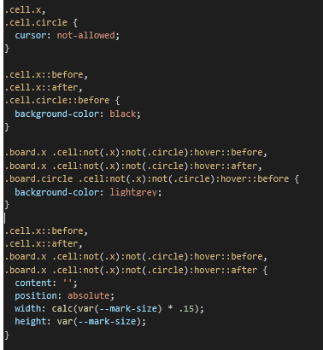
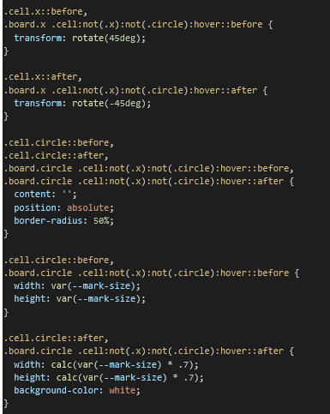
Exercise 5 – Graphical updates for gameplay
Currently the placeMark function won’t actually change the GUI when we load the webpage. We’re going to add quite a large section of CSS:
For the O’s it’s quite simple to draw a circle. The X’s require us to create two lines and rotate them clockwise 45 degrees and anti-clockwise 45 degrees. The references to ‘hover’ are for functionality we will add later upon which hovering the mouse over a cell with cast a shadow of the symbol we would use. For now though we’ve just told the CSS to change the display when the JavaScript adds the values ‘x’ or ‘circle’ to the cell.

Slide 14

Exercise 6 – Endgame messages
In our JavaScript file we’re currently calling a function that we haven’t looked at yet called “endGame()” which accepts a Boolean as an argument.
This Boolean should just determines whether the match ended in a draw or not. This function should be used to provide end of game messages. However, as the HTML and CSS files currently stand, there is no message pop-up so we should start there.
In the HTML file there should be a div class named “winning-message”. In this div we want to insert some more HTML. It should look like this:
From the names, you can probably guess that we’re going to also include a restart button so users can replay if they’d like to.

Slide 15
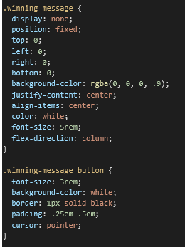
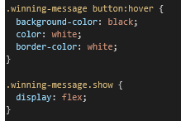

Moving on to the CSS we can format these HTML elements further by adding into the root section:
So we’ve added the HTML components and stylised them with CSS. Now we need to add some logic to them with JavaScript. So if we remember from earlier, we need to first obtain the HTML components we want to interact with in script.js. We need to include at the top:
So we’re getting the winning message and restart button by ID and using querySelector() to get the text stored in the message.

Slide 16
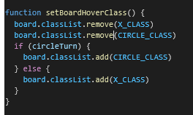
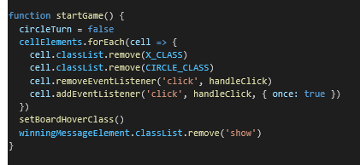
Exercise 7 – Mouse hovering
Now that we’ve got the game completed we can add some more style choices to it. One that we mentioned earlier and pasted in a little bit of code for is the hover capability. This will add more interactivity with the game and make it easier to play.
So to make a hover, we’re going to make a new function called setBoardHoverClass. The first thing we want to do in this function is remove any classes from the cells classList. Then using if statements on the circleTurn Boolean we want to add the O or the X class to the cell. See if you can build this using knowledge from other functions we’ve made today.
You should end up with something like this:
You might notice now that if you open the HTML in your browser, the first click won’t have hover functionality. This is because the setBoardHoverClass function is called in the handleClick function so is only set up then. We need to add a call to this function in startGame as well:

Slide 17

The large CSS segment that we added in Exercise 5 contains the stylisation for the hover.
Where the CSS deals with adding the symbol to a cell it also deals with the case of adding a hover symbol.
CSS has an inbuilt “:hover” selector that can be used on any HTML element and triggers when the user hovers the mouse over it.
We were able to add some logic to this as well within the CSS file removing the need to do this in JavaScript. For example, this section which we pasted in Exercise 5 stops the hover function applying to cells that already have been chosen by a player in a prior turn:

Slide 18

Exercise 8 – Final stylisation
When played on pen and paper, Noughts and Crosses can be played by drawing the board with just 4 lines. We can remove the exterior lines of the cells to better stylise the game. Using the same numbering convention from before of:
0 1 2
3 4 5
6 7 8
In the CSS file we can use the commands border-top, border-left, border-right and border-bottom to remove the exterior borders.
The first one we want to do it:
See if you can figure out the other commands...

Slide 19
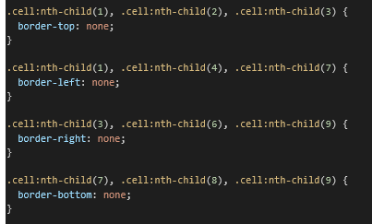
Exercise 8 solution…

Slide 20
That about covers it for building our Noughts and Crosses game. You are all welcome to develop the code further and add more features as you see fit. Just to give you a few ideas of things you can look at in your spare time:
Possible extensions:
Customise the webpage further, learn how to change colours and maybe assign each team a colour/let them choose one.
Allow players to input usernames.
Currently the game is declared draw when all cells are filled and no win conditions are satisfied. Look into how to have the game decide at the end of each turn if a win is possible so users don’t have to carry on filling out all the cells.
Score board functionality to tally up wins over multiple games.

